Slide 1
User Interaction
Android Developer Fundamentals V2
Lesson 4

Slide 2
4.1 Buttons and clickable images

Slide 3
Contents
User interaction
Buttons
Clickable images
Floating action button
Common gestures

Slide 4
User interaction

Slide 5
Users expect to interact with apps
Tapping or clicking, typing, using gestures, and talking
Buttons perform actions
Other UI elements enable data input and navigation

Slide 6
User interaction design
Important to be obvious, easy, and consistent:
Think about how users will use your app
Minimize steps
Use UI elements that are easy to access, understand, use
Follow Android best practices
Meet user's expectations

Slide 7
Buttons

Slide 8






Button
View that responds to tapping (clicking) or pressing
Usually text or visuals indicate what will happen when tapped
State: normal, focused, disabled, pressed, on/off

Slide 9
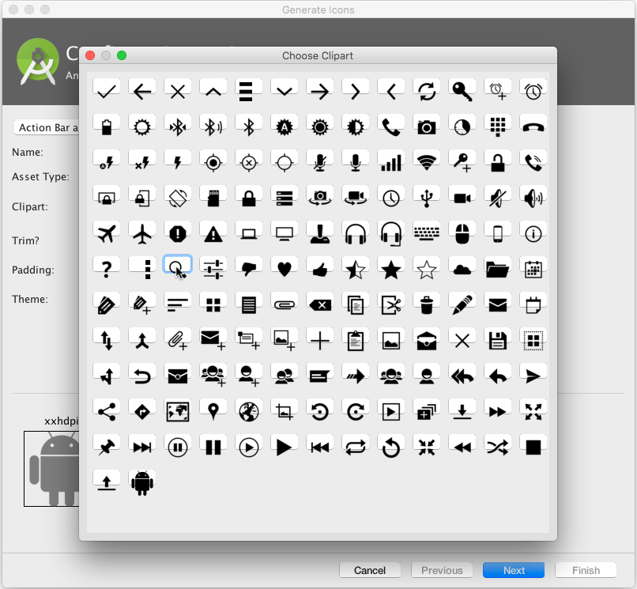
Button image assets
Right-click app/res/drawable
Choose New > Image Asset
Choose Action Bar and Tab Items from drop down menu
Click the Clipart: image (the Android logo)
Experiment:
Choose New > Vector Asset

Slide 10




Responding to button taps
In your code: Use OnClickListener event listener.
In XML: use android:onClick attribute in the XML layout:
<Button
android:id="@+id/button_send"
android:layout_width="wrap_content"
android:layout_height="wrap_content"
android:text="@string/button_send"
android:onClick="sendMessage" />
android:onClick
Notes:
A click event occurs when the user taps or clicks a button, or an image used as a button. The object notifies an event listener called OnClickListener, which is an interface in the View class. You can use the listener to respond to a click event.
Android Studio provides a shortcut for setting up an OnClickListener for the clickable object in your Activity code, and for assigning a callback method: use the android:onClick attribute with the clickable object’s element in the XML layout. For example:
<Button
android:id="@+id/button_send"
android:layout_width="wrap_content"
android:layout_height="wrap_content"
android:text="@string/button_send"
android:onClick="sendMessage" />
In this case, when a user clicks the button, the Android system calls the Activity’s sendMessage() method.

Slide 11
Setting listener with onClick callback
Button button = findViewById(R.id.button);
button.setOnClickListener(new View.OnClickListener() {
public void onClick(View v) {
// Do something in response to button click
}
});

Slide 12
Clickable images

Slide 13
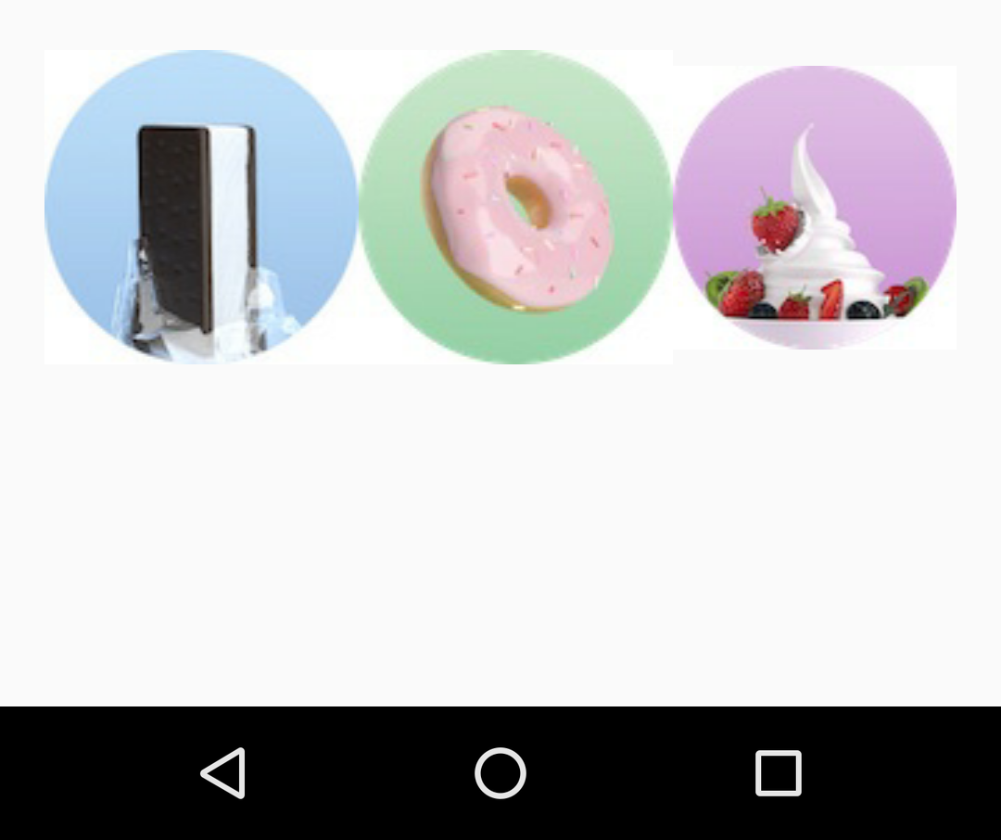




ImageView
ImageView with android:onClick attribute
Image for ImageView in app>src>main>res>drawable folder in project

Slide 14


Responding to ImageView taps
In your code: Use OnClickListener event listener.
In XML: use android:onClick attribute in the XML layout:
<ImageView
android:layout_width="wrap_content"
android:layout_height="wrap_content"
android:src="@drawable/donut_circle"
android:onClick="orderDonut"/>
android:onClick
Notes:
A click event occurs when the user taps or clicks a button, or an image used as a button. The object notifies an event listener called OnClickListener, which is an interface in the View class. You can use the listener to respond to a click event.
Android Studio provides a shortcut for setting up an OnClickListener for the clickable object in your Activity code, and for assigning a callback method: use the android:onClick attribute with the clickable object’s element in the XML layout. For example:
<Button
android:id="@+id/button_send"
android:layout_width="wrap_content"
android:layout_height="wrap_content"
android:text="@string/button_send"
android:onClick="sendMessage" />
In this case, when a user clicks the button, the Android system calls the Activity’s sendMessage() method.

Slide 15
Floating action button

Slide 16
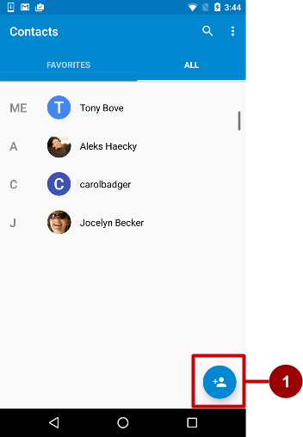

Floating Action Buttons (FAB)
Raised, circular, floats above layout
Primary or "promoted" action for a screen
One per screen
For example:
Add Contact button in Contacts app

Slide 17
Using FABs
Start with Basic Activity template
Layout:
<android.support.design.widget.FloatingActionButton
android:id="@+id/fab"
android:layout_gravity="bottom|end"
android:layout_margin="@dimen/fab_margin"
android:src="@drawable/ic_fab_chat_button_white"
.../>

Slide 18
FAB size
56 x 56 dp by default
Set mini size (30 x 40 dp) with app:fabSize attribute:
app:fabSize="mini"
Set to 56 x 56 dp (default):
app:fabSize="normal"

Slide 19
Common Gestures

Slide 20
Touch Gestures
Touch gestures include:
long touch
double-tap
fling
drag
scroll
pinch
Don’t depend on touch gestures for app's basic behavior!

Slide 21
Detect gestures
Classes and methods are available to help you handle gestures.
GestureDetectorCompat class for common gestures
MotionEvent class for motion events

Slide 22
Detecting all types of gestures
Gather data about touch events.
Interpret the data to see if it meets the criteria for any of the gestures your app supports.
Read more about how to handle gestures in the Android developer documentation
Notes:
To detect all types of gestures, you need to perform two essential steps:
Gather data about touch events.
Interpret the data to see if it meets the criteria for any of the gestures your app supports.
The gesture starts when the user first touches the screen, continues as the system tracks the position of the user's finger(s), and ends by capturing the final event of the user's fingers leaving the screen. Throughout this interaction, an object of the MotionEvent class is delivered to onTouchEvent(), providing the details of every interaction. Your app can use the data provided by the MotionEvent to determine if a gesture it cares about happened.

Slide 23
Learn more
Input Controls
Drawable Resources
Floating Action Button
Radio Buttons
Specifying the Input Method Type
Handling Keyboard Input
Text Fields
Buttons
Spinners
Dialogs
Fragments
Input Events
Pickers
Using Touch Gestures
Gestures design guide

Slide 24
What's Next?
Concept Chapter: 4.1 Buttons and clickable images
Practical: 4.1 Clickable images

Slide 25
END

